Slide 1
Final Presentation Capstone Design
Team members:
Akbarali Otakahnov (Ali) – 20152777
Sardorbek Ibrokhimov (Sardor) – 20152778 (Team Leader)
Kobiljon Ikromjanov (Kobil) – 20152779
DSU
Professor: 강대기

Slide 2
Content
Introduction
Overall Project
Plan vs Progress Chart
Used Materials
Summarization of the Project
Conclusion
Future work
DSU

Slide 3
Introduction
Project name: The Secured Home System via Penta. Penta is a kind of new device that includes multifunctional ways to lock and unlock the door at a time.
Goal: The main proposed target is getting the Penta product for securing the places and achieving a strong surveillance beside the entrance of…
Intended clients: Individuals/Companies.
DSU

Slide 4
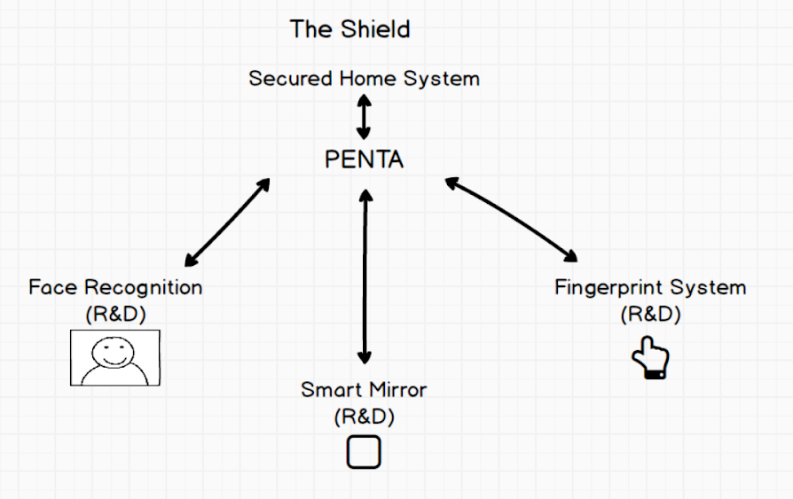
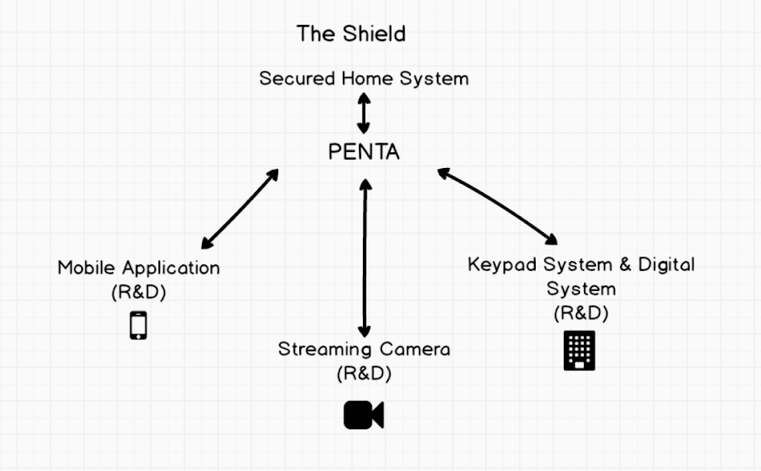
Overall Project
Capstone Design Part
Security Project Part
DSU

Slide 5
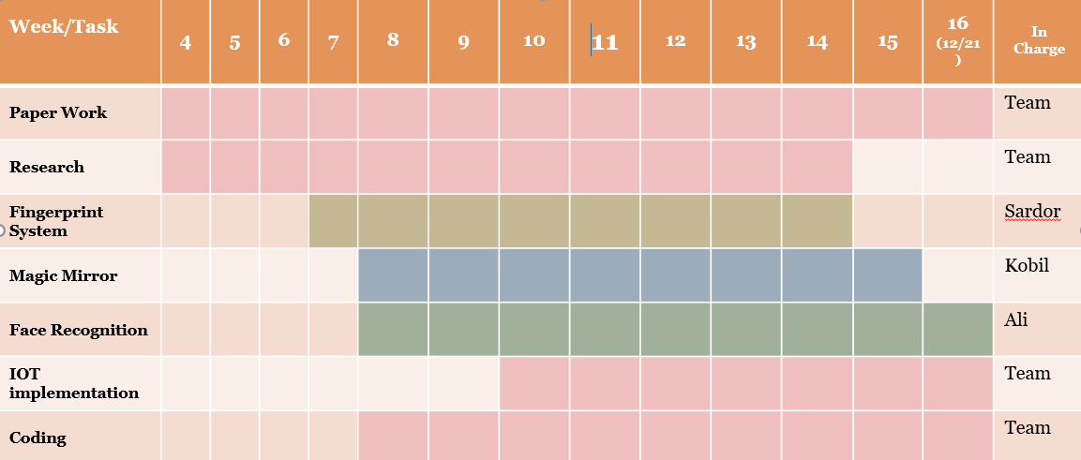
Plan Table
DSU
Gradient colors mean the tasks that had been done

Slide 6
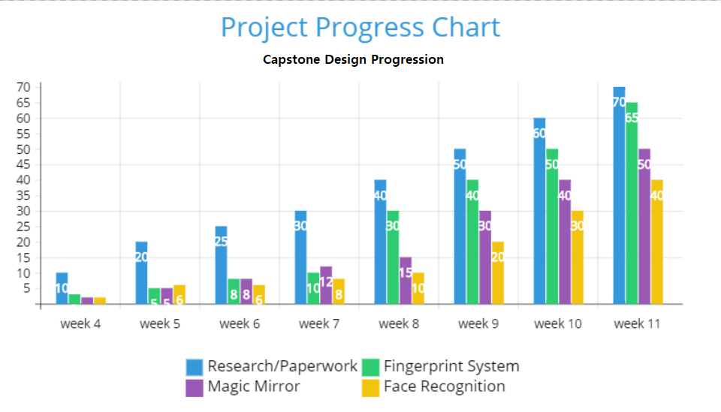
Progress Table (Till the Mid-Term)
DSU

Slide 7
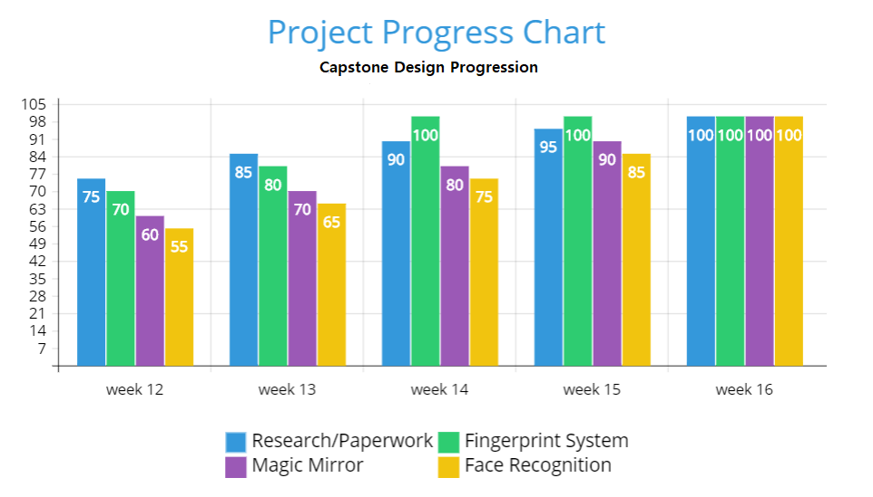
Progress Table (After the Mid-Term)
DSU

Slide 8
Used Tools
End requirements for the project:
Raspberry Pi 3 model B;
Registers;
Cables;
Motherboard;
Arduino LCD Screen;
Keypad
Mobile phone;
Raspberry Pi Camera for the Streaming Camera
End requirements for the project:
Linux Operating System;
Python Programming Language;
Node.js;
Blynk Cloud Server;
Time library package;
Git_hub library package;
Json library package;
Adafruit library package;
Npm library package.

Slide 9
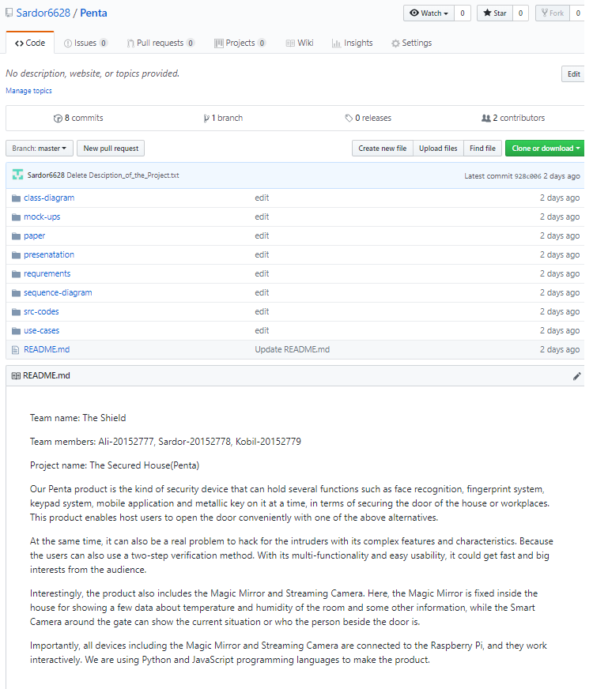

Slide 10
Summary of the Project
We have achieved the security system that works with
Raspberry Pi. This system gives us the product Penta that
holds a few technologies such as: (The Part of Capstone Design Class)
Face recognition;
Fingerprint System;
Magic Mirror.
They all work interactively with each other. We have achieved to run main parts of the coding process in Python programming language using the Linux Operating System.
DSU

Slide 11
Conclusion
The proposed system strengthens somehow the security conditions considerably, and it has several multifunctional ways to lock and unlock the door at a time.
Besides, it has a Magic Mirror that shows some important data about the condition of the room and others.
Additionally, the user can watch the video on the Magic Mirror.
Importantly, the intended and ongoing project is mainly build on Raspberry Pi using a Python programming language using Linux Operating System in order to contribute to the development of the Door Security System on the places.
All existing products interact to each other and work collaboratively.
DSU

Slide 12
Future work
In the future, more functions and new technologies can be carried out on this system and more features can be incorporated.
For instance we can implement the designed digital lock technology that can sense physical impact of unauthorized visitor and notify the host user’s mobile device.
Besides, we also think about to develop our system with QR coded and digitized cards which means, the users can utilize them in terms of unlocking the door.
DSU

Slide 13
Thanks for your attention!
If (any comments or questions)
{
printf(“you are welcome!”);
}
Else
{
printf(“we have done!”);
}
DSU

